Slide 1
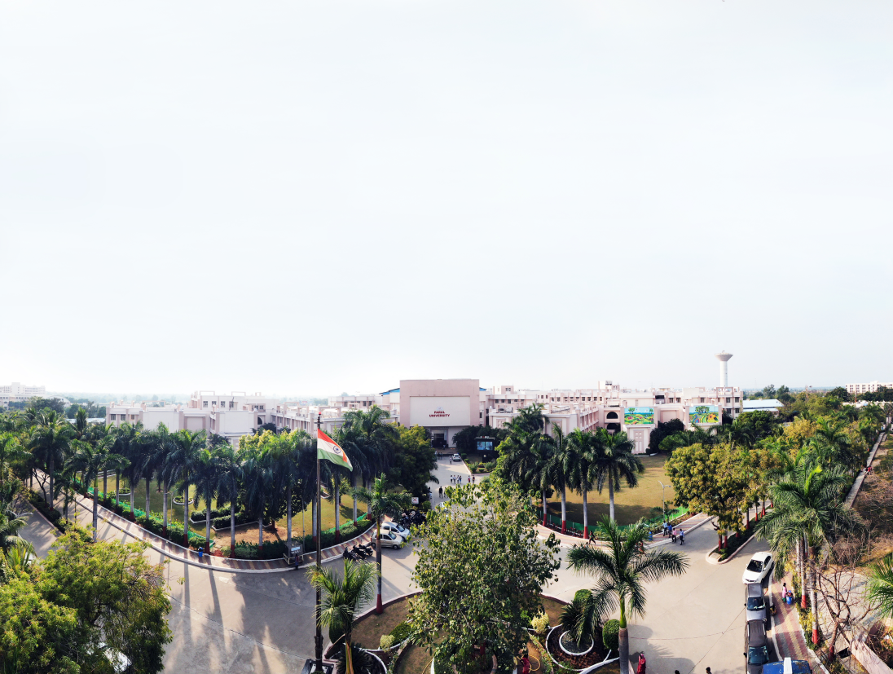


PARULINSTITUTEOF ENGINEERING &TECHNOLOGY
FACULTY OF ENGINEERING & TECHNOLOGY
PARULUNIVERSITY
Subject: WEB DESIGN
Unit 4: Responsive Web Design & Advanced CSS
Computer Science & Engineering

Slide 2
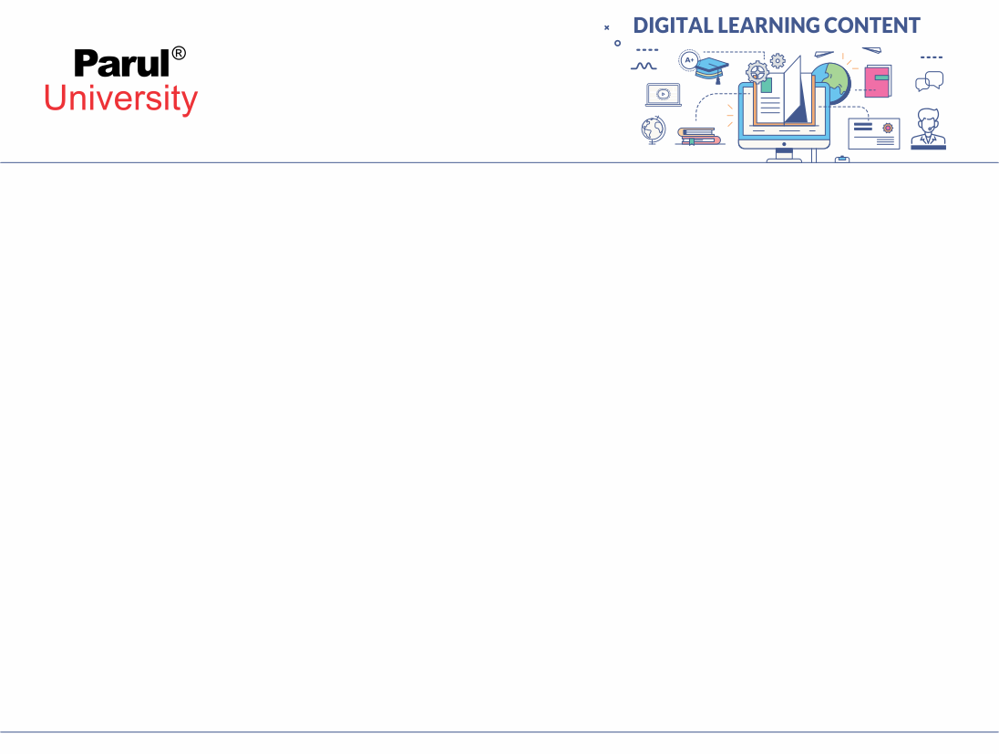


Outline
Media Queries for Responsive Design . CSS Transitions and Animations (transition 4property, duration, timing-function, delay, animation-name, iteration-count, direction).CSS Variables & Advanced Styling (shadow, gradient, border-radius).Templates (Pre-defined template, How to use it?)

Slide 3
Responsive Web Design
What is Responsive Design?
Websites adapt to different screen sizes (PC, tablet, mobile)
Improves user experience
Achieved using CSS media queries

Slide 4
True Positive Rate (TPR)
Media Queries
Allow applying CSS based on device size
@media (max-width: 600px) {
body { background-color: lightblue; }
}
Example: Change background for mobile screens

Slide 5
False Positive Rate (FPR)
Why Responsive Design?
Mobile-friendly websites
No horizontal scrolling
Google SEO ranking improvement

Slide 6
CSS Transitions & Animations
CSS Transitions
Used for smooth state changes
Properties:
transition-property
transition-duration
transition-timing-function
transition-delay

Slide 7
CSS Transitions & Animations
button {
transition: background 0.5s ease;
}
button:hover { background: red; }

Slide 8
CSS Animations
More advanced than transitions
Properties:
animation-name
animation-duration
animation-iteration-count
animation-direction

Slide 9
CSS Animations
@keyframes slide {
from { left: 0px; }
to { left: 200px; }
}
div { animation: slide 3s infinite; }

Slide 10
Transition vs Animation
Transition → needs trigger (hover, click)
Animation → runs automatically (looped if needed)
Side-by-side comparison diagram

Slide 11
CSS Variables & Advanced Styling
CSS Variables
Custom properties to reuse values
:root { --main-color: blue; }
p { color: var(--main-color); }

Slide 12
Shadows
text-shadow → add shadow to text
box-shadow → add shadow to elements

Slide 13
Gradient Backgrounds
linear-gradient()
radial-gradient()
background: linear-gradient(to right, red, yellow);

Slide 14
Rounded Corners
border-radius: 10px;
Makes boxes or images circular/rounded

Slide 15
Templates
Pre-defined CSS frameworks/templates save time
Examples: Bootstrap, Tailwind CSS
Provide ready-made layouts & components

Slide 16
How to Use a Template?
1. Download or link CSS template file
2. Use predefined classes in HTML
<link rel="stylesheet" href="bootstrap.css">
<button class="btn btn-primary">Click</button>

Slide 17
Introduction to NLP
Thank You!!!

Slide 18




www.paruluniversity.ac.in

